Slide 1
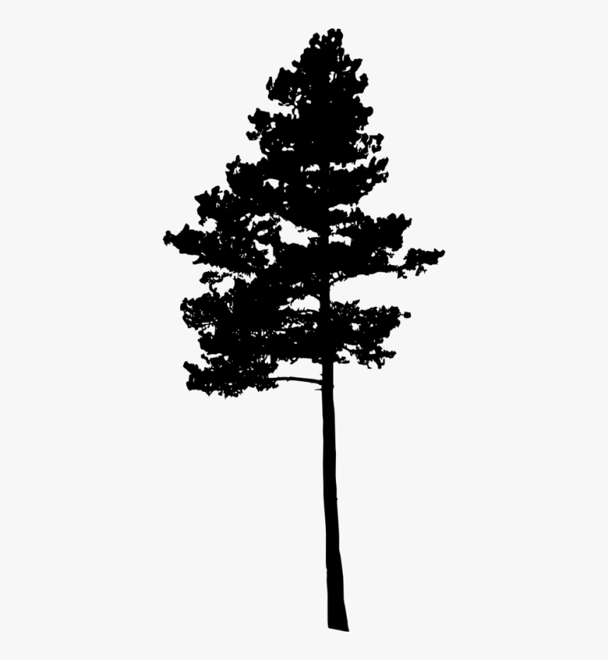
Impacts of Genetic Variation and Silvicultural Treatments on Loblolly Pine Water Use
By
Azura Liu
Dr. Sari Palmroth, Advisor, Dr. Christopher Maier, Advisor
Notes:
Slide 1: working title, with your name(s), client (if applicable), and advisor(s)
Briefly introduce loblolly pine (one sentence) on elastic traits-why there’s research interest

Slide 2
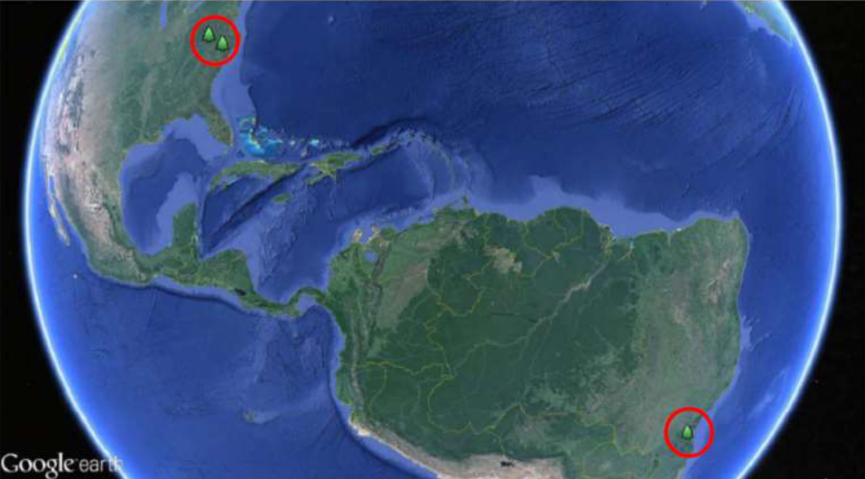




Background
Part of a larger project:
North Carolina State University
Virginia Tech
United States Forest Service
Federal University of Santa Catarina, Brazil
Three sites:
NC Coastal Plain
Virginia Piedmont
Brazil
Notes:
Slide 2: client, if applicable Say something about who the client is and what they do.

Slide 3
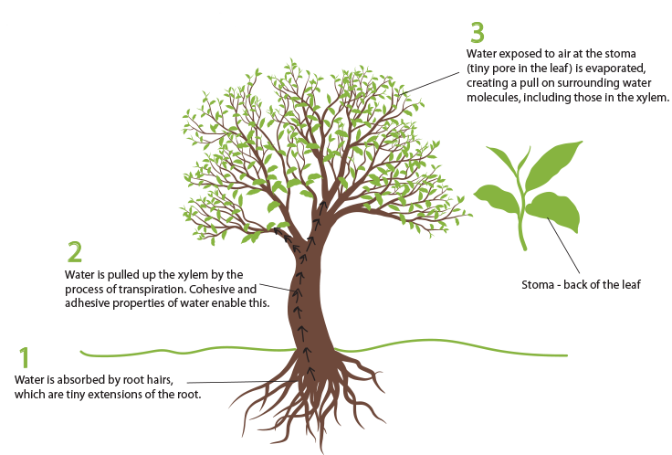
CONTEXT: Transpiration
Crown architecture
Planting density
Water content in the air
Soil water availability
@Bridging The Gap
Notes:
Plant transpiration is an integrate part of local and global carbon and hydrological cycle (Jasechko et al., 2013). Water moves passively from soil into the atmosphere through plant root, xylem, and shoots, carrying necessary nutrients and supports photosynthesis (Sinha, 2004). Transpiration is defined as the amount of water used in this process (Hanrahan, 2011).
Transpiration responds to both biotic and abiotic factors including individual tree crown architecture, planting density, water content in the air, and water availability. Transpiration changes with tree characteristics as the conductance of water flow varies with each tree’s physiology and morphology. ).

Slide 4
Goals & Objectives
To better understand P. taeda physiology
Does transpiration differ with genotype and planting density?
How does transpiration respond to environmental variables?
Notes:
Slide 4: broad or overarching goal of the project short and sweet on the slide; but you can say more in your presentation. If you are working with a client, you might be able to lift this from their project proposal.

Slide 5
Specific Objectives
1. Does transpiration differ with genotype and planting density?
Examining each component of transpiration by treatment
2. How does transpiration respond to environmental variables?
Examining seasonal tends
Examining the transpiration response to environmental variables
Vapor pressure deficit (VPD)
Relative extractable water (REW)
Notes:
Slide 5: specific objectives Itemize a few of these (3 or so). These will guide the rest of your presentation. At this stage, you might not be ready with these. One purpose of these presentations is to let us help you refine these.

Slide 6
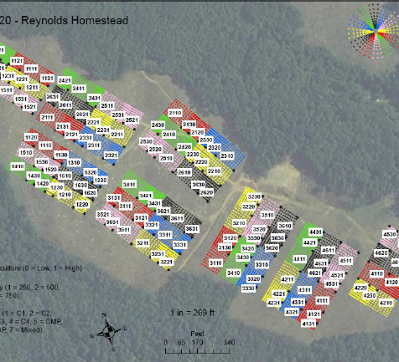
The Experiment
Study design
4 genotypes
2 densities
Notes:
Slide 3: context What is this project about, in general? What background will the audience need, so that they can understand what you did?
-Explain the role of each variable like in report introduction
-

Slide 7
Approach: measurements & Data Analysis
Field Measurements
Statistical Analysis
Data Cleaning & Error check
Notes:
Slide 6: approach A simple statement about how you’ll do this. Is this a geospatial project? Interviews?

Slide 8
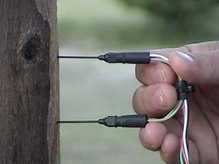
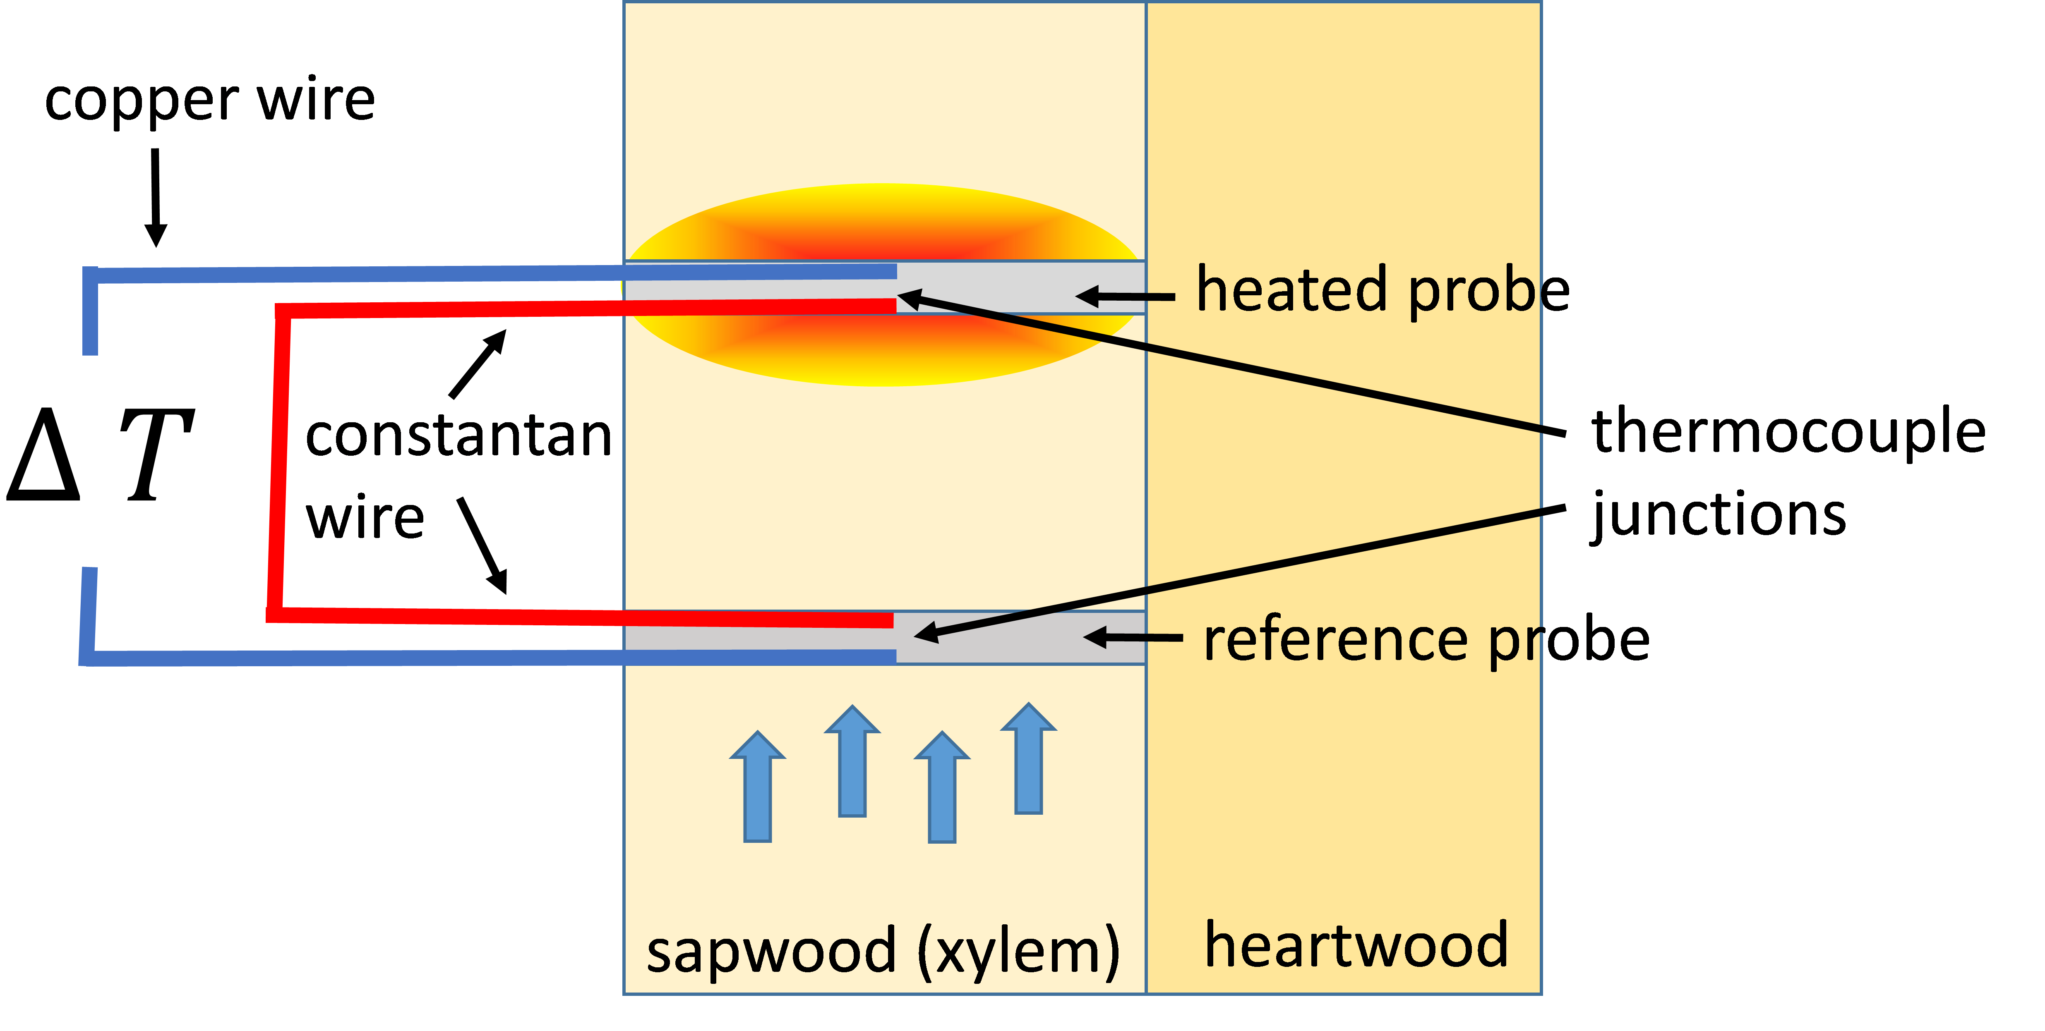
Method: Measurements
Data measured during growing season 2017, stand age 9
Sapflux measurements
Granier’s probe
Diameter at breast height (DBH)
Environmental variables
@ICT International
Notes:
Slide 7: methods (as far as you can say) You will probably have specific methods for each of your itemized objectives. You probably won’t have these fleshed out just yet; again, the purpose of these presentations is to give us an opportunity to refine these with you.
https://www.ictinternational.com/products/tdp/tdp-thermal-dissipation-granier/
https://camdenl08.wordpress.com/2014/04/14/sap-flow/

Slide 9
Method: Scaling
DBH Measurements
Daily Diameter
Daily Sapwood Area
Temperature Difference
Sapflux Density
Sapflow
X Sapwood Area
Notes:
Briefly talk through
mention probe t test and elaborate next slide
scaling

Slide 10
Method: Statistical Analysis
Analysis of variance (ANOVA)
Sapflux
Sapflow
Analysis of covariance (ANCOVA)
Sapflow response to dryness of the air
Sapflow response to soil water availability
Sapwood area

Slide 11
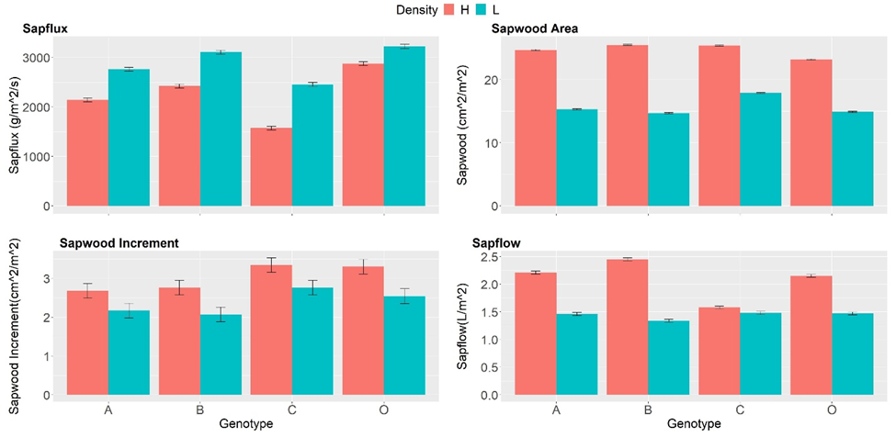

Results: Sapwood, & Sapflow
Notes:
Mean average of sapwood area and sapflow over 4 months
-greater sapwood->greater sapflow->interactions

Slide 12
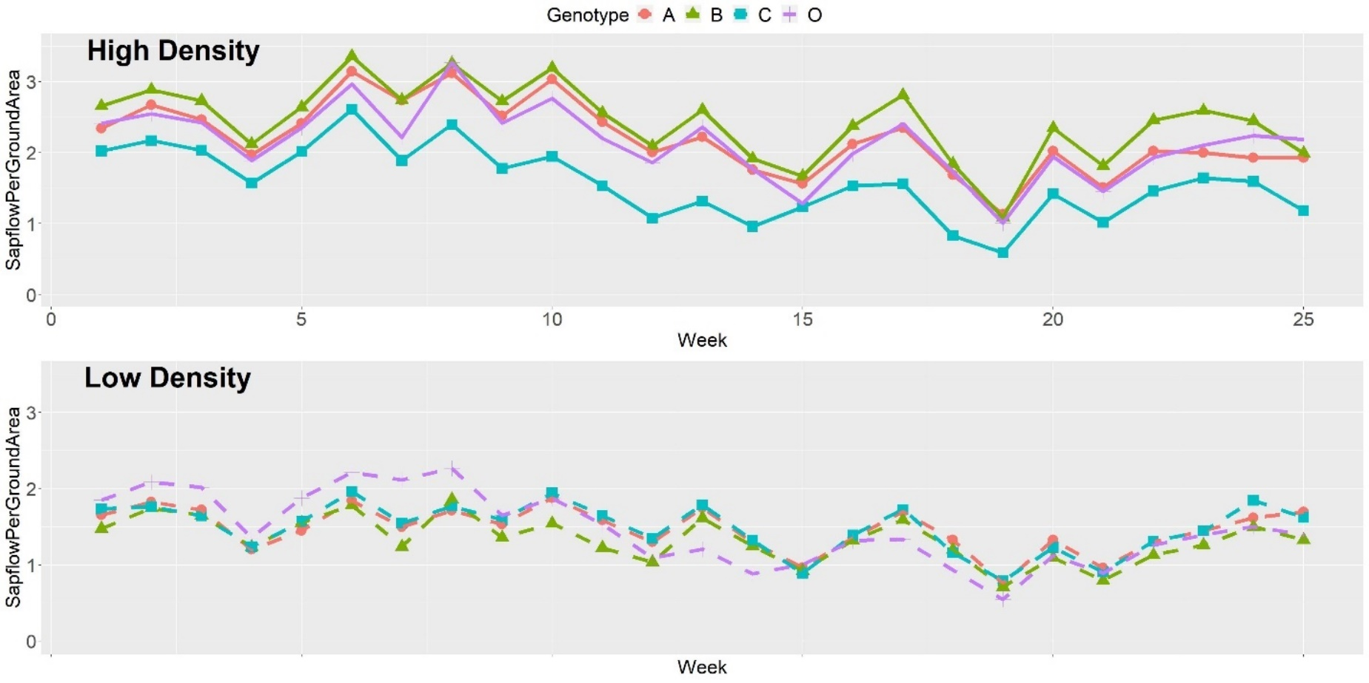
Results: Seasonal Trend
Notes:
weekly averages reduces variability

Slide 13
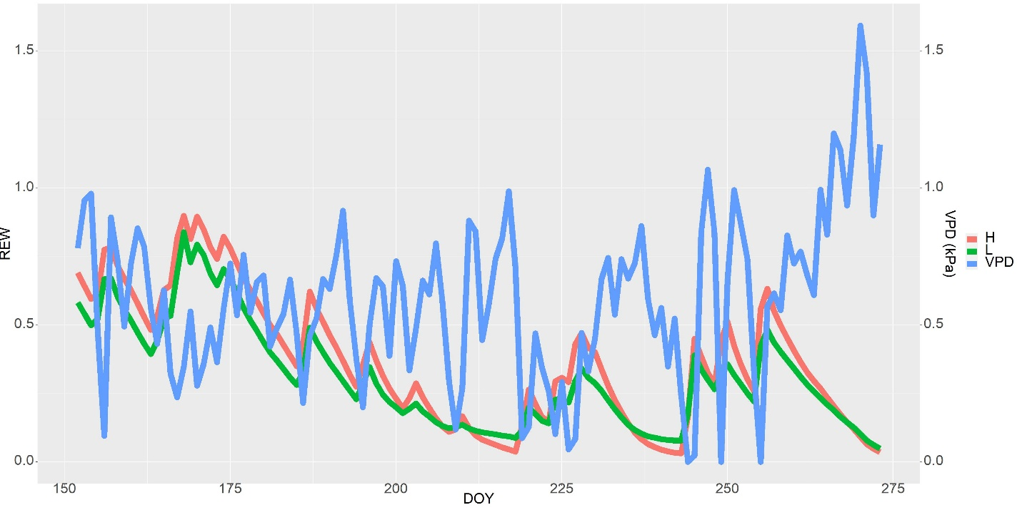
Results: Environmental Variables
Notes:
Slide 8: expected form of results For each objective, what will the result look like? Will it be a regression table, a map, or what? Thinking about this now can really help you focus your work going forward.

Slide 14
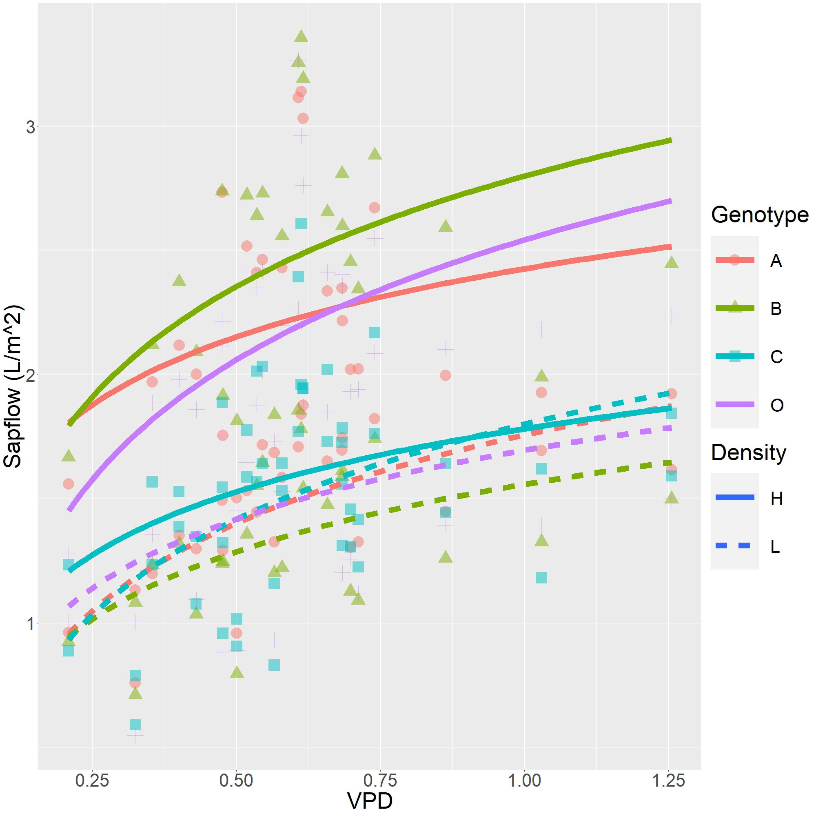
Results: Effect of VPD
Notes:
the greatest differences were found in narrow-crowned C3, and the lowest differences were found in broadest-crowned C4
-genotype planted in opposite densities-transpire poorly
-

Slide 15
Conclusion
Density and genotype had significant effects on sapflux, sapwood, sapflow, and transpiration response to water availability in the air and soil.
When genotype B (narrow crown) and C (broadest crown) were planted in a density unfavorable to their innate crown architecture, they showed consistently lower sapflow and lower transpiration response to water availability in the air and soil.
Though saflow was the highest when genotype B was planted under high density and when genotype C was planted under low density, sapwood area was consistently highest in broadest-crowned genotype C.

Slide 16
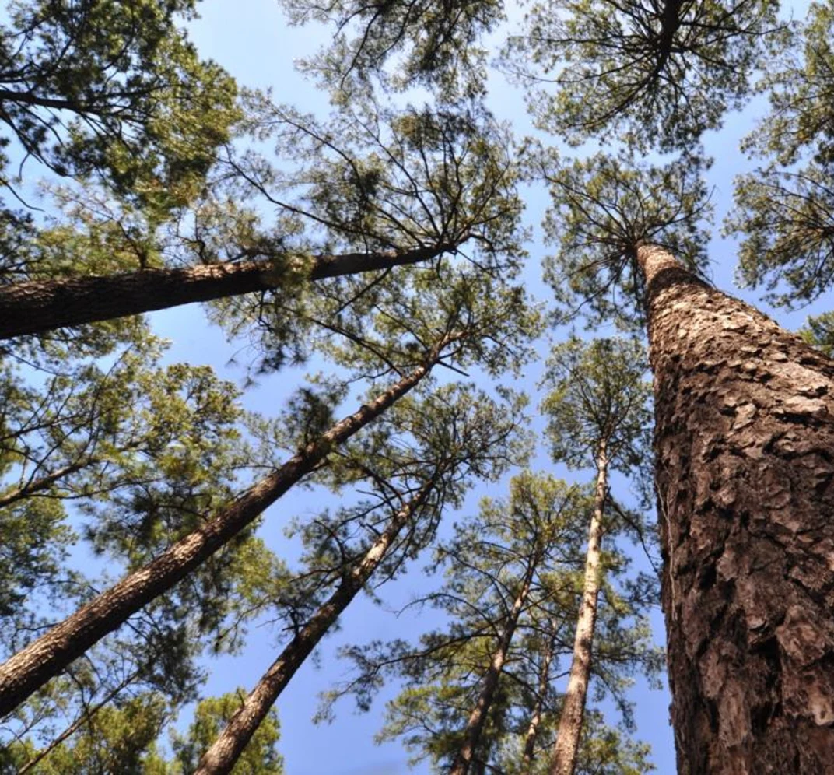
Broader Impact
P. taeda is of high ecological and economical potentials
Management
Genetic selection
Environment control
Further research
Specific crown properties
Other locations?
@ArborGen
Notes:
Slide 9: significance of this finished project Why will it be a good thing for you to have done this project? Who will benefit from this, and how will they use your results?

Slide 17
Thank you
Questions?

